Slide 1
Norton Featherbed Frames
Handling Excellence
1950-1969

Slide 2
Norton frames in 1949
The plunger suspended frame was Norton’s production and racing frame at the time.
It was called the “garden gate” since it had some wobble issues even though it was a great breakthrough when brought out in the late 1930’s.
The stresses of racing were causing frame breakage in the older design. Engines were being continually advanced.
The Norton International single-cylinder engine in 350cc and 500cc was used, called a “Manx” engine when developed and used for racing.

Slide 3
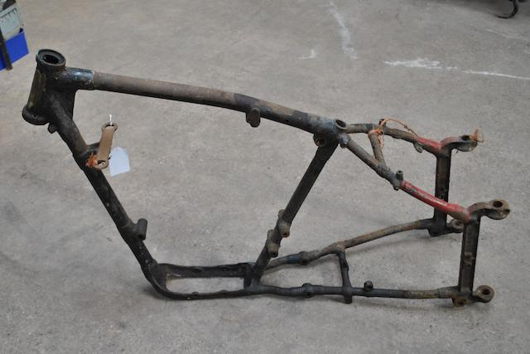

Slide 4
The Featherbed was developed for racing
Norton was trying to stay competitive with the 500cc Manx single cylinder engine.
Rex McCandless was a racer that developed a frame for his Triumph 500 that was known to be innovative.
Norton hired him to develop a frame for their road racers, hoping that better handling and braking would keep them competitive with AJS engines and the developing Gilera four-cylinder engine.
The new frame with a Manx 500cc engine first debuted in April 1950 with a win at the Blanford circuit in England.

Slide 5
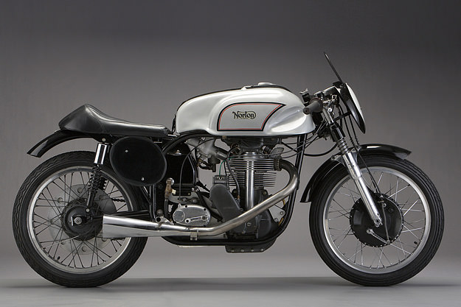

Slide 6
Norton Featherbed at the 1950 Isle of Man
Harold Daniell, an accomplished TT racer, during testing, said this frame was like “riding on a featherbed” compared to the previous Norton plunger “garden gate” frame.
The name has stuck ever since.
Geoff Duke bested Daniell’s 12-year-old record in the Senior TT on the Norton Manx with the featherbed frame, best lap of 93.33 mph.
A featherbed framed Norton also won the Junior TT (350 cc).
A very limited supply of Norton 500cc Manx racers with the new frame were made available in 1951. A limiting factor was Reynolds Tubing welding output.

Slide 7
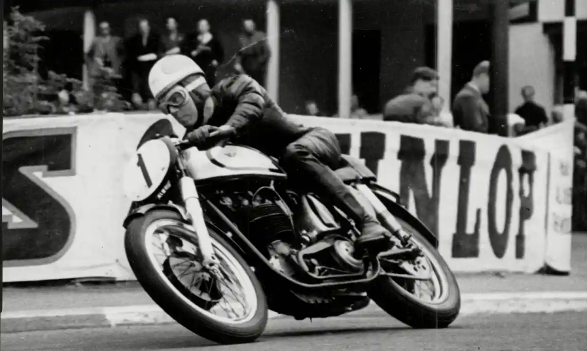

Slide 8
Norton Featherbed in production motorcycles
First went on the model 88 500cc Dominator in 1952. Production motorcycles used mild steel tubing as opposed to the Reynolds alloy steel tubing.
Then on the model 99 600cc Dominator in 1956.
The 650cc Norton Manxman and the 650SS used the featherbed frame in 1960.
In 1962, the 750 Atlas used the featherbed frame until it was discontinued in 1968. The Commando sported an all-new frame when it debuted in 1967.
In 1960, the top frame rails were narrowed, creating the “slimline” frame.
In 1959, the single -cylinder ES2 received a featherbed frame before being discontinued in 1964.

Slide 9
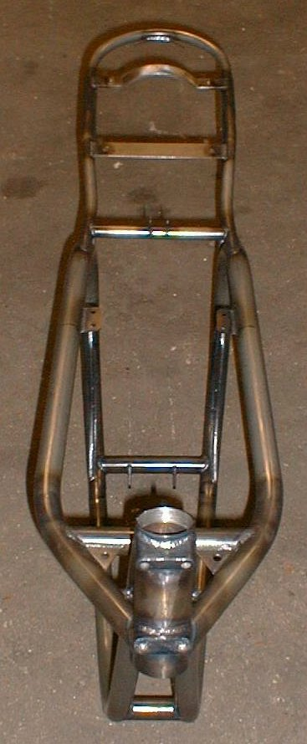

Slide 10
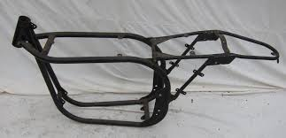

Slide 11
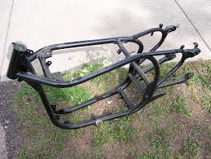

Slide 12
Featherbed Hybrids
The featherbed frame was known as one of the best handling frames at the time due to its all-welded (not brazed) construction, twin loop design, light weight, and rigidity.
Its wide-open engine compartment meant that many different engines could be placed in the frame.
This included Triumphs, Vincents, BSA’s, Harleys, etc.
Engine mounting plates were developed for the different motors.

Slide 13
Welding vs. Brazing
Brazed joints, tube and lug
Welded joints, Silicon-Bronze welding

Slide 15
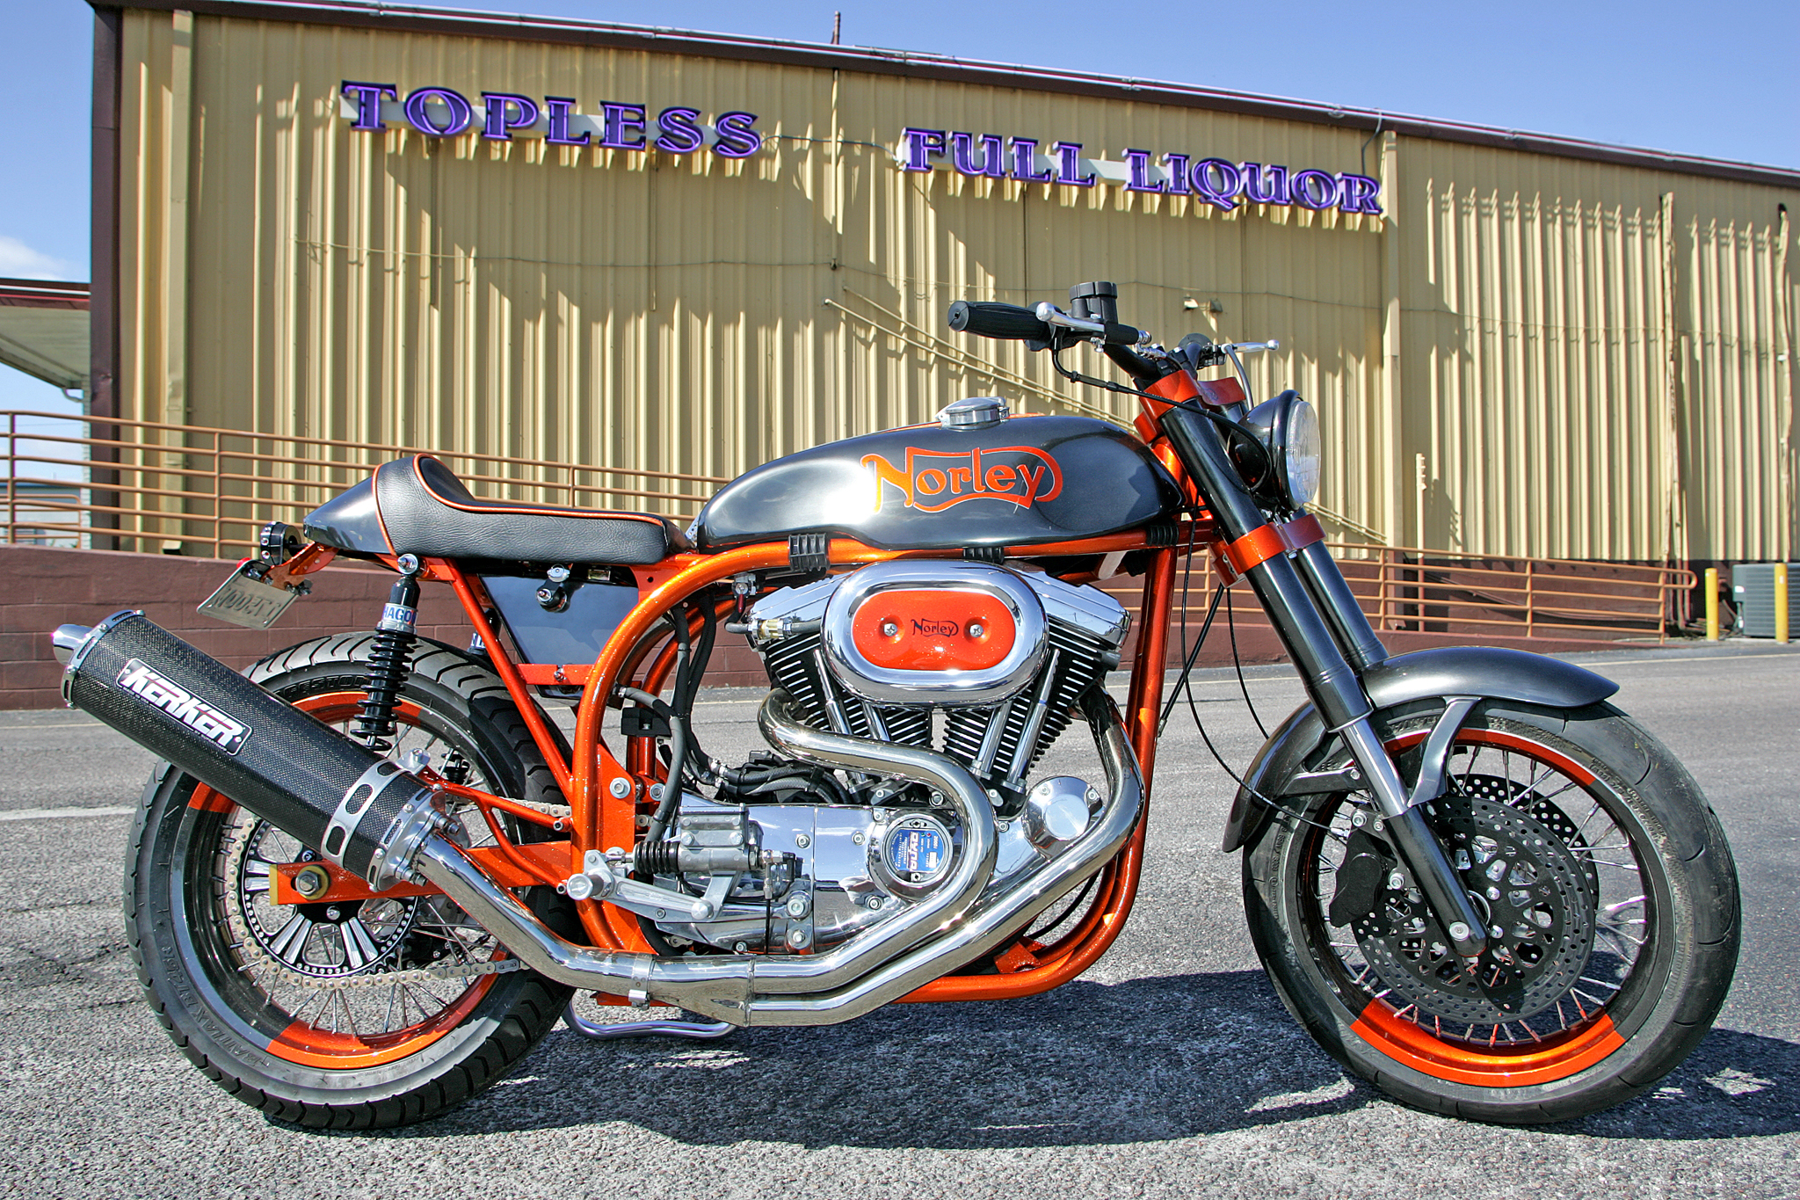

Slide 16
The Triton, a 1960’s custom.
Manx 500cc engines were used for car racing in the F500 class.
Norton would not sell a separate engine, only a complete motorcycle.
This made Norton featherbed rolling chassis available, and Triumph engines were often put in them.
The Triumph twin engines were faster than the Norton twins, so they had some favor to put in a Norton frame.
The Triton thing was big in the 60’s, then the Bonnevilles and the Commandos made making a custom motorcycle less desirable.

Slide 17
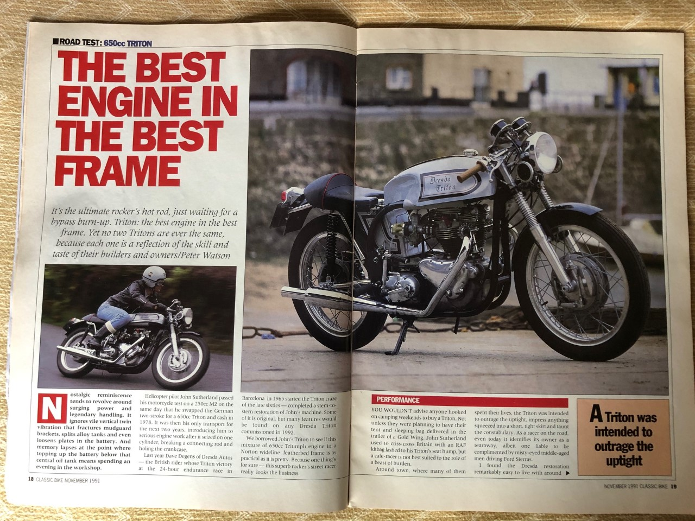

Slide 18
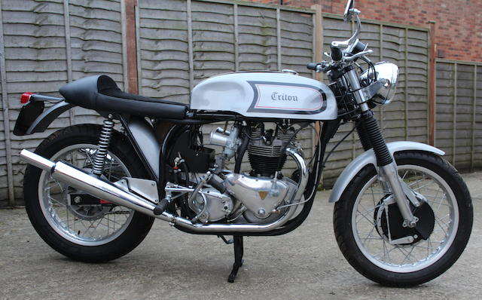

Slide 19
